Slide 1
Assessing the Generalizability of Temporally-Coherent Echocardiography Video Segmentation
Yida Chen, Xiaoyan Zhang,
Christopher M. Haggerty, Joshua V. Stough

Slide 2
Outline
Echocardiography
Frame vs. Video Segmentation
CAMUS Dataset
Experimental Results
Generalization to EchoNet-Dynamic

Slide 3
Echocardiography
Common Modality
Non-invasive test and rapid acquisition
Ouyang et al. Video-based AI for beat-to-beat assessment of cardiac function https://www.nature.com/articles/s41586-020-2145-8

Slide 4
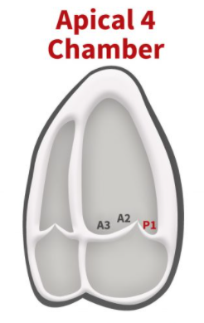
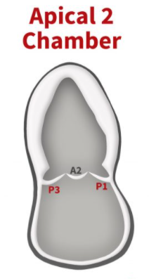
Echocardiography
Common Modality
Non-invasive test and rapid acquisition
2 Standard Views used for Left Ventricular Volume & Ejection Fraction (EF) estimation
https://www.cardioserv.net/echo-mitral-valve/

Slide 5
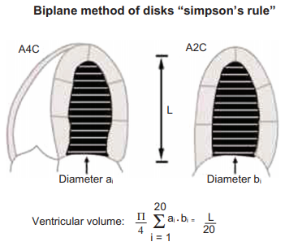
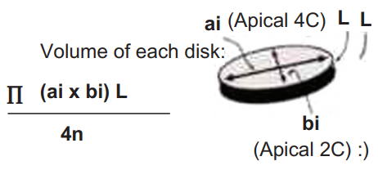
Echocardiography
Common Modality
Non-invasive test and rapid acquisition
AP 2CH/4CH Views
Behnia et al. Clinical Medicine Insights 2013. https://doi.org/10.4137/CCRPM.S12498

Slide 6
Echocardiography
Common Modality
Non-invasive test and rapid acquisition
AP 2CH/4CH Views
Labor-intensive manual annotation
High Inter/intra-variability
Behnia et al. Clinical Medicine Insights 2013. https://doi.org/10.4137/CCRPM.S12498

Slide 7
Outline
Echocardiography
Frame vs.Video Segmentation
CAMUS Dataset
Experimental Results
Generalization to EchoNet-Dynamic

Slide 8
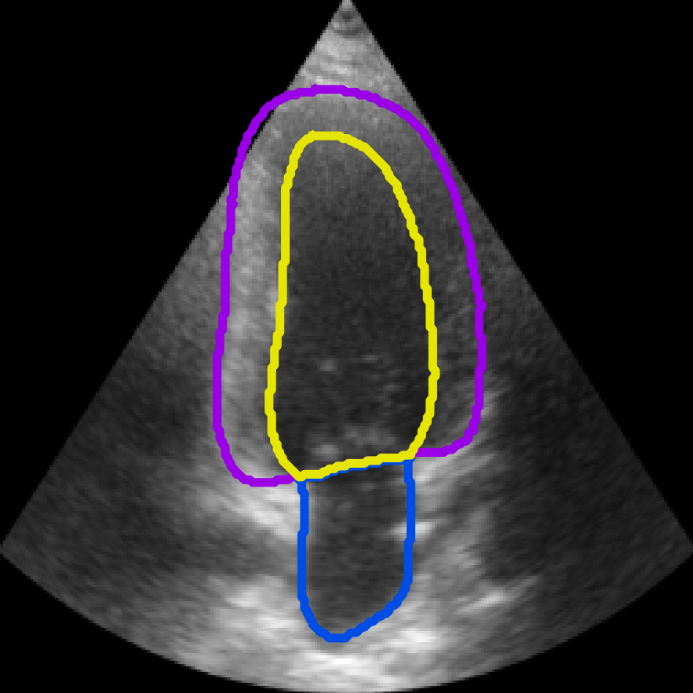
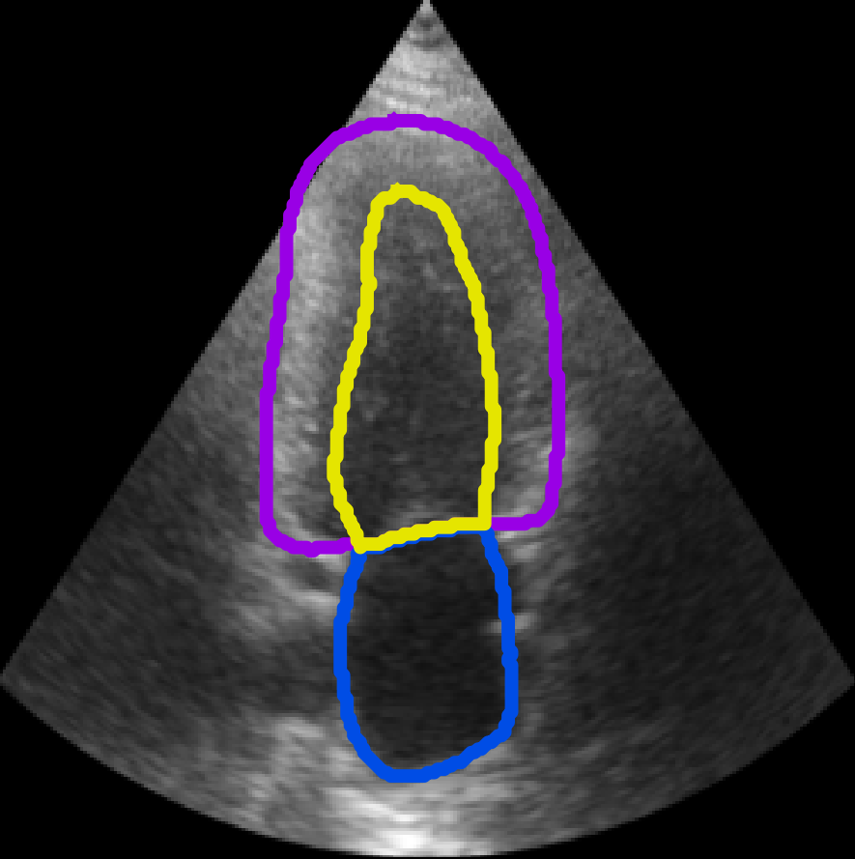
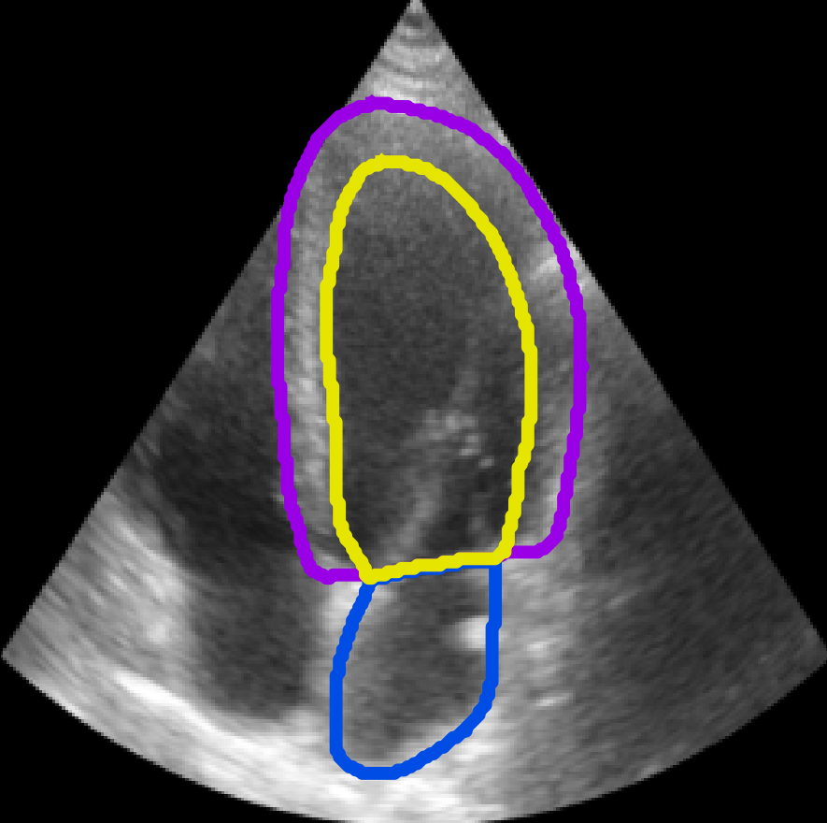
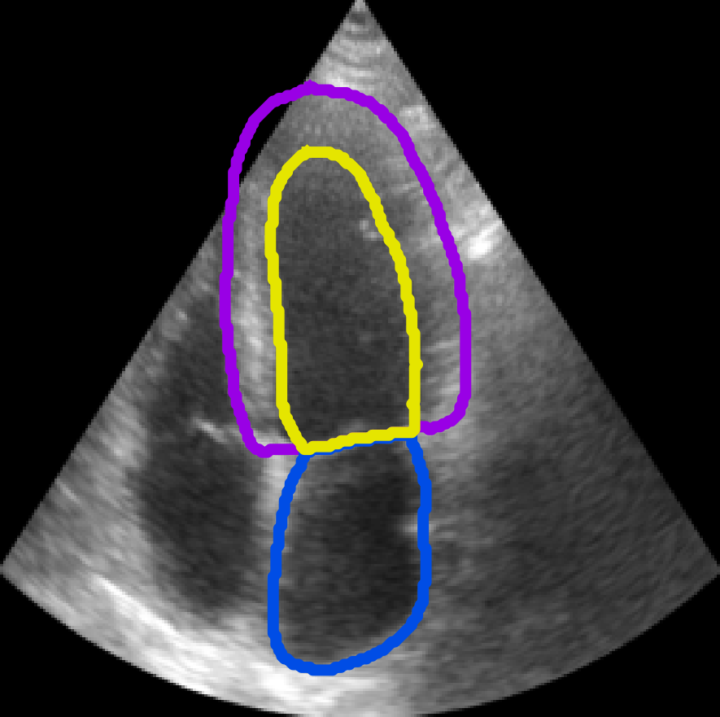
Frame Segmentation
AP 2CH ED AP 2CH ES
Focus on spatial features
Accurate segmentation
Frames are analyzed independently
Little to no connection between segmented frames
Incommensurate performance on the 3D index, EF
AP 4CH ED AP 4CH ES
Stough et al. SPIE Medical Imaging 2020. https://doi.org/10.1117/12.2547375

Slide 9
Video Segmentation
Analyze ED-ES video clips
Extract both spatial and temporal features
Temporal-coherent segmentation
Improved estimation on EDV, ESV, & EF
AP 2CH
AP 4CH

Slide 10
CAMUS Dataset
500 patients
450 Training
50 Hold-out Tests
AP 2 & AP 4 Views
Segmented ED/ES
LV Endocardium
LV Epicardium
LA
Clinical indices are given
AP 4CH AP 2CH
LeClerc et al., IEEE TMI 2019, https://doi.org/10.1109/TMI.2019.2900516

Slide 11
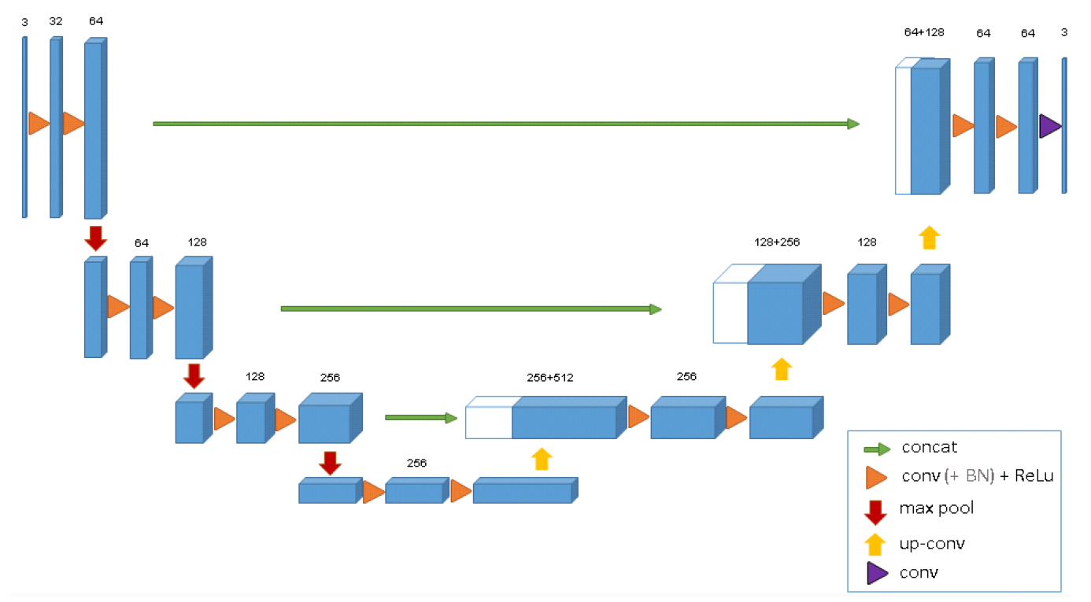
CNN: CLAS
3D Convolutions
O, Cicek et al. 3D U-Net: Learning Dense Volumetric Segmentation from Sparse Annotation https://arxiv.org/pdf/1606.06650.pdf
Wei et al. MICCAI 20, http://doi-org-443.webvpn.fjmu.edu.cn/10.1007/978-3-030-59713-9_60

Slide 12
CNN: CLAS
3D Convolutions
~19M weights
Two parallel tasks: Segmentation & Motion Tracking
Wei et al. MICCAI 20, http://doi-org-443.webvpn.fjmu.edu.cn/10.1007/978-3-030-59713-9_60

Slide 13
Outline
Echocardiography
Frame vs. Video Segmentation
CAMUS Dataset
Experimental Results
Generalization to EchoNet-Dynamic

Slide 14
Experiment on CAMUS
10-fold cross-validation
Same split for Frame¹ and CLAS methods
Stratified on EF & Image quality
Image Quality | EF Range :Good Med Poor; <45 >55 else​
fold 0 (49): 43 41 16; 29 43 29​
fold 1 (49): 43 41 16; 29 43 29​
fold 2 (46): 43 43 13; 26 43 30​
fold 3 (46): 43 43 13; 26 43 30​
fold 4 (46): 43 43 13; 26 43 30​
fold 5 (44): 45 43 11; 25 45 30​
fold 6 (43): 44 44 12; 26 47 28​
fold 7 (43): 44 44 12; 26 47 28​
fold 8 (43): 44 44 12; 26 47 28​
fold 9 (41): 46 41 12; 27 46 27 ​
1. Stough et al. SPIE Medical Imaging 2020. https://doi.org/10.1117/12.2547375

Slide 15
10-fold CV Results
CAMUS 450 Training
Dice Similarity
1. Wei et al. MICCAI 20, http://doi-org-443.webvpn.fjmu.edu.cn/10.1007/978-3-030-59713-9_60
2. Stough et al. SPIE Medical Imaging 2020. https://doi.org/10.1117/12.2547375

Slide 16
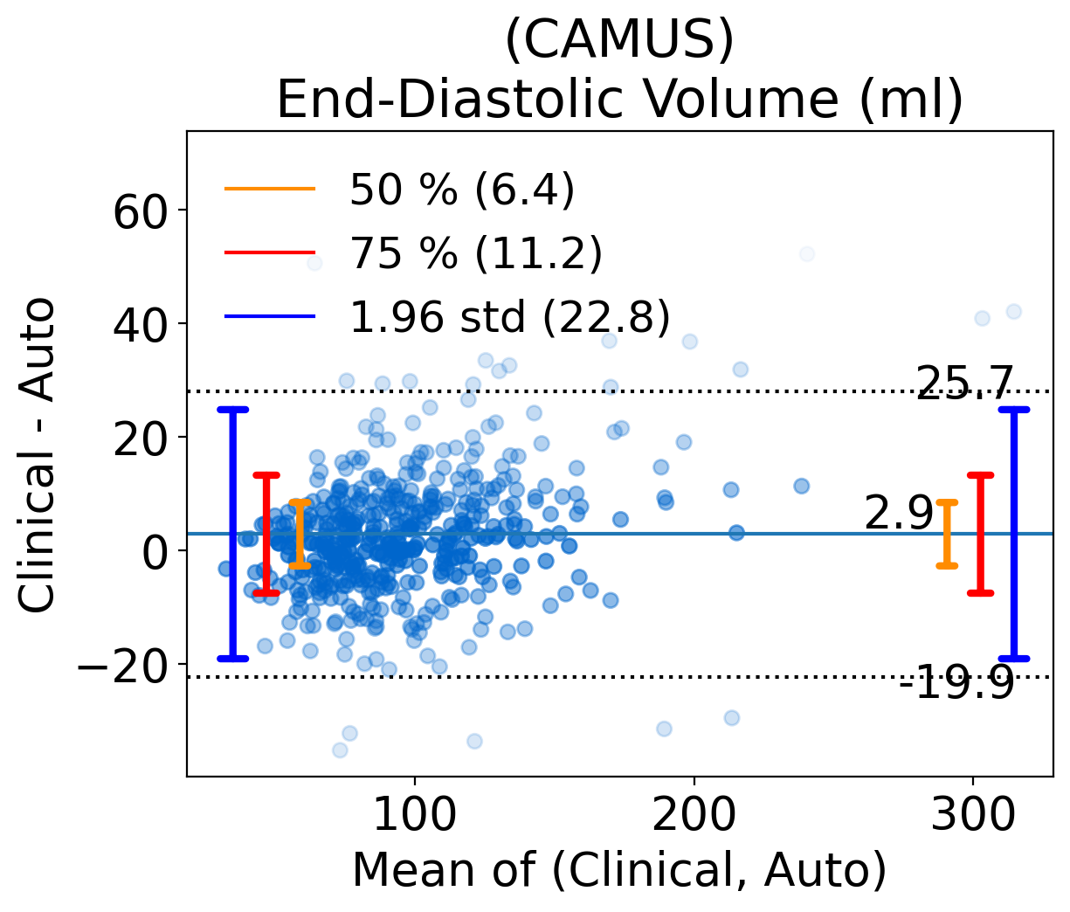
Derived LV Volume
Improved LV volume estimation
On End-Diastolic Volume:
mae (vs. Frame):
8.7 ml vs. 9.9 ml
LOA (vs. Human expert):
± 22.8 vs. ± 25.2
……..Wood, et al., Echocardiography 2014, https://doi.org/10.1111/echo.12331

Slide 17
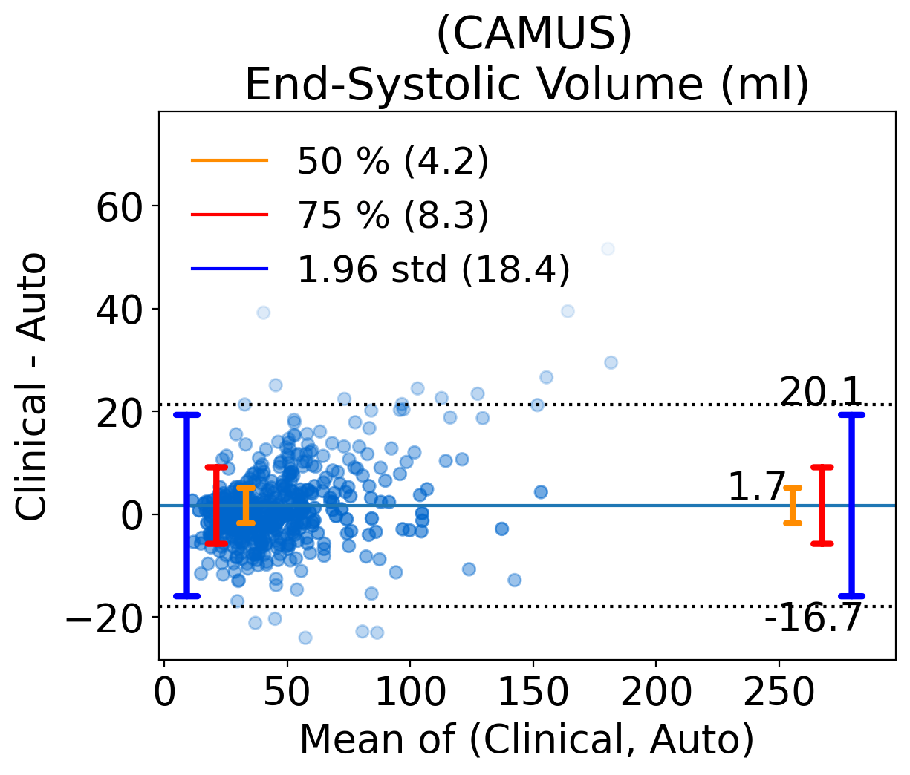
Derived LV Volume
Improved LV volume estimation
On End-Systolic Volume:
mae (vs. Frame):
6.3 ml vs. 6.6 ml
LOA (vs. Human expert):
± 18.4 vs. ± 19.6
……..Wood, et al., Echocardiography 2014, https://doi.org/10.1111/echo.12331

Slide 18
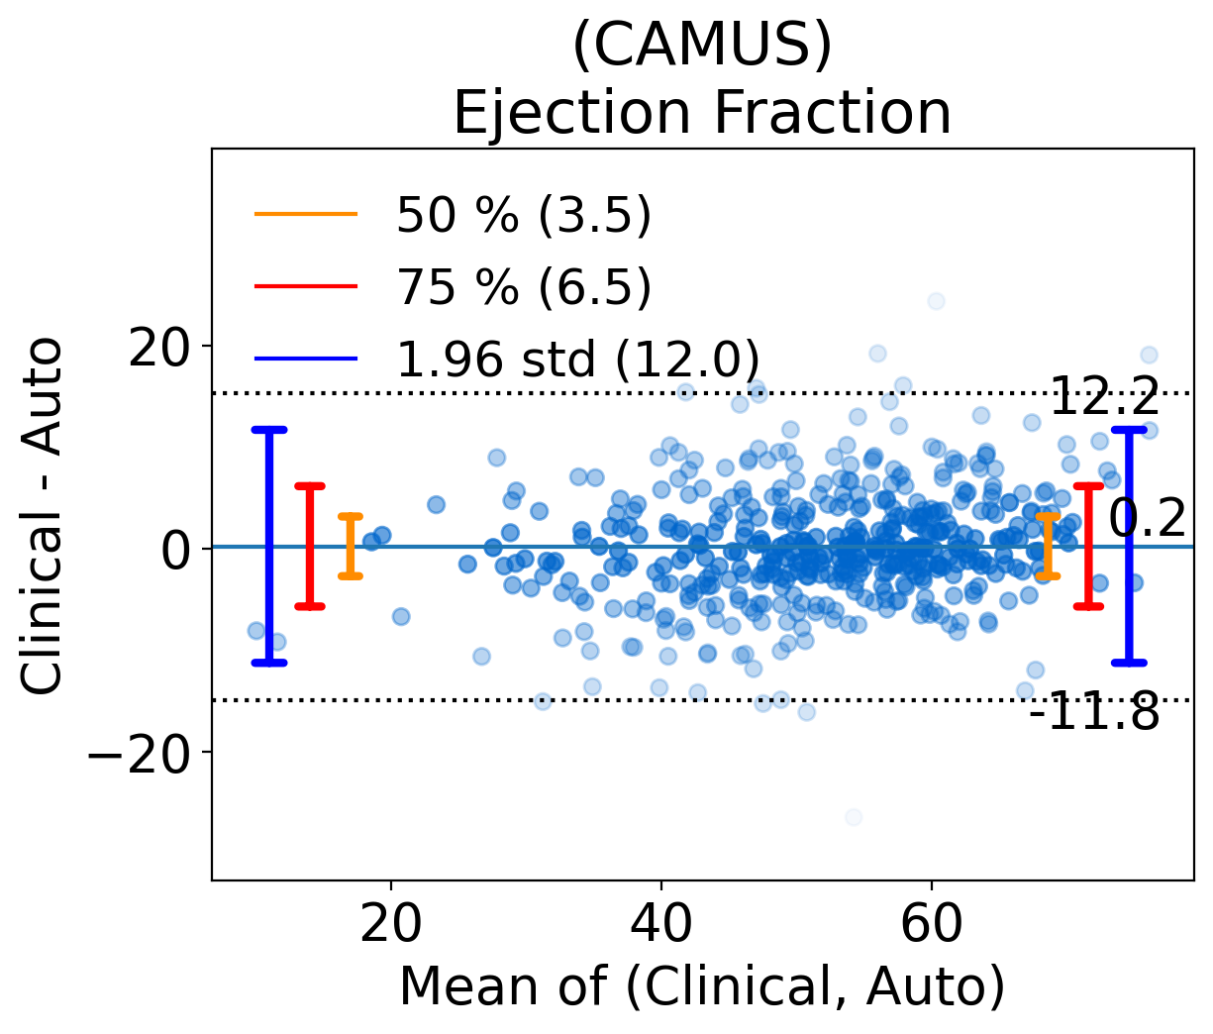
Derived Ejection Fraction
Accurate EF derivation
mae (vs. Frame):
4.6% vs. 5.3%
LOA (vs. Human expert):
± 12.0% vs. ± 15.1%
……..Wood, et al., Echocardiography 2014, https://doi.org/10.1111/echo.12331

Slide 19
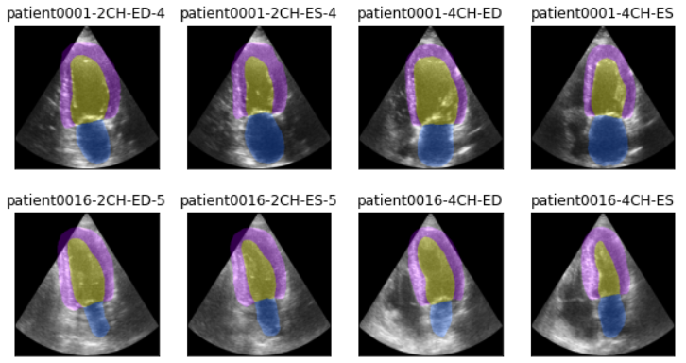
50 Hold-out Test Patients
Use accumulated outputs from 10-fold models
Answers are submitted to the online platform
LeClerc et al., IEEE TMI 2019, https://doi.org/10.1109/TMI.2019.2900516

Slide 20
50 Hold-out Test Patients
Compared against best-reported on the platform
Consistent Dices
Better EDV, ESV, and EF estimation

Slide 21
Outline
Echocardiography
Frame vs. Video Segmentation
CAMUS Dataset
Experimental Results
Generalization to EchoNet-Dynamic

Slide 22
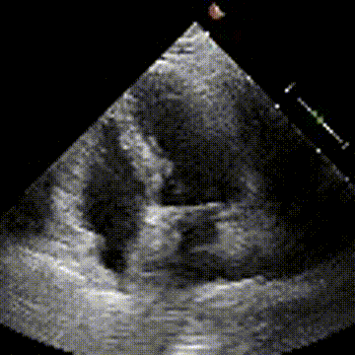
EchoNet-Dynamic
10,030 echo videos
Multiple heartbeats
Akin to clinical quality
Annotated LV in ED/ES
AP 4CH view only
Ouyang et al. Video-based AI for beat-to-beat assessment of cardiac function https://www.nature.com/articles/s41586-020-2145-8

Slide 23
Putative ED-ES clips
Only one pair of clinical reported ED/ES frame indexes is given for each video.
To fully utilize the video information

Slide 24
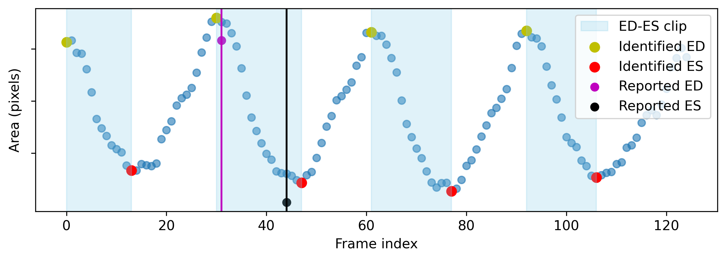
Putative ED-ES clips
Determined from segmented LV sizes¹ (in pixels)
Local maxima ⇒ ED; Local minima ⇒ ES
1. Ouyang et al. Video-based AI for beat-to-beat assessment of cardiac function https://www.nature.com/articles/s41586-020-2145-8

Slide 25
Test-time Augmentation
EF 59.86%
EF 60.76%
EF 59.98%
EF 58.75%

Slide 26
Test-time Augmentation
Derived EF: 59.84%
Clinical EF: 59.06%
Abs Error: 0.78%

Slide 27
Performance on Test Set
1274 patients
Dice Similarity (LV ED/ES)
A-CLAS: 0.91/0.88
Frame: 0.91/0.88

Slide 28
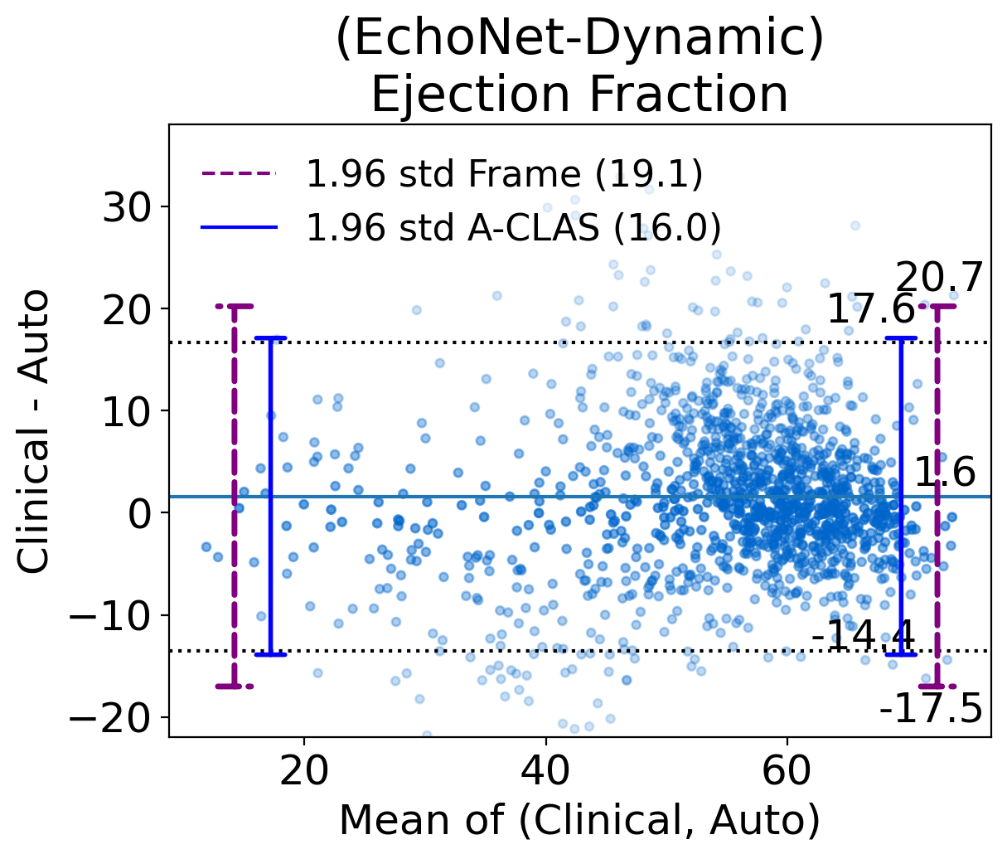
Performance on Test Set
1274 patients
Dice Similarity (LV ED/ES)
A-CLAS: 0.91/0.88
Frame: 0.91/0.88
Narrower LOA
1.60 % ± 16.0 (vs. 19.1)
Higher cross-correlation 0.77 (vs. 0.70)

Slide 29
Conclusion
Incorporate temporal coherence & Depend less on spatial features
Resistant to imaging artifacts & noise
Improved EDV, ESV, & EF estimations
Well generalized to larger unseen dataset without tuning

Slide 30
Thank You
Joshua V. Stough, PhD
Xiaoyan Zhang, PhD
Christopher M. Haggerty, PhD
Ciffolillo Healthcare Technology Inventors Program

