Slide 1
Assessing the Impact of Block-Selective Homopolymers on the Diffusion of Payloads Through Polymeric Gels
Ian Coates - Kalman Research Symposium 4/17/21

Slide 2
Applications
Current Methods:
Notes:
Currently the most efficient systems of drug delivery include: 1) Orally ingested tablets such as pills or syrups and 2) Injectable solutions such as shots
To deliver these therapeutic payloads to a targeted part of the body scientists rely on diffusion
To protect these drugs from biological processes, like digestion, payloads are treated with potentially toxic compounds
Instead we will investigate alternative pathways for controlled drug delivery

Slide 3
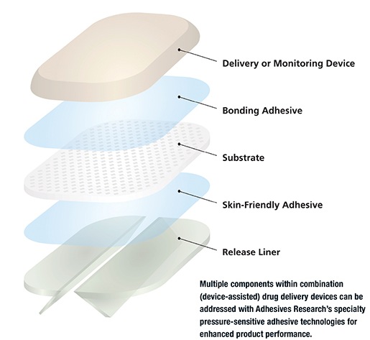
Applications
Transdermal Delivery Patches:
Polymeric Delivery Gels:
Tunable drug delivery rate
Mechanically robust
Minimally Invasive
Notes:
Transdermal patches (pictured on the left) are devices worn on the external of the skin.
These devices are designed to deliver drugs directly through the dermis into the circulatory system.
In addition to direct delivery these devices provide a mechanism to tune payload delivery are minimally invasive and mechanically robust.
However, adoption of this technology has stalled because if a patch rips burst delivery can occur resulting in a potential overdose.
For widescale application further investigation of transdermal drug patches must be performed. Specifically, in this talk i will investigate engineering the delivery properties of these patches.

Slide 4
Approach
Styrenic gels provide spatiotemporal control:
Physical Gel Nanostructure
Payload (Drug) Complex
Notes:
Polymer based gels have been found to function well as transdermal drug patches as the are both mechanically robust and can be tuned to control the release rate, or diffusion, of pharmaceutical drugs
Specifically there are two methods to control drug delivery 1) Alter the gel nanostructure or 2) Alter the payload complex
In my research I will investigate the effect altering gel nanostructure has on the release rate of a specified drug

Slide 5
Background
Physical Crosslinks Micelle
Bridging Crosslink
Nanocarrier
Notes:
First lets look at a typical polymer gel.
3 main phase selective regions represented in the figure
Purple domains represent physically crosslinked polystyrene which form micelles
Dark green bridging the purple micelles represents gel crosslinks linking the polystyrene micelles together
Blue region represents the nanocarrier or model drug of the system.

Slide 6
Background
Styrene-Ethylene-Butylene-Styrene (SEBS)
Sodium Dioctyl Sulfosuccinate (AOT)
Notes:
So what makes up each of these components?
The polymeric gels in this study are composed of SEBS block polymer consisting of two base units styrene and ethylene butylene.
Specifically the purple reverse micelles are composed of styrene monomer while the bridging crosslinks are composed of ethylene butylene
Lastly the model drug is represented by AOT

Slide 7
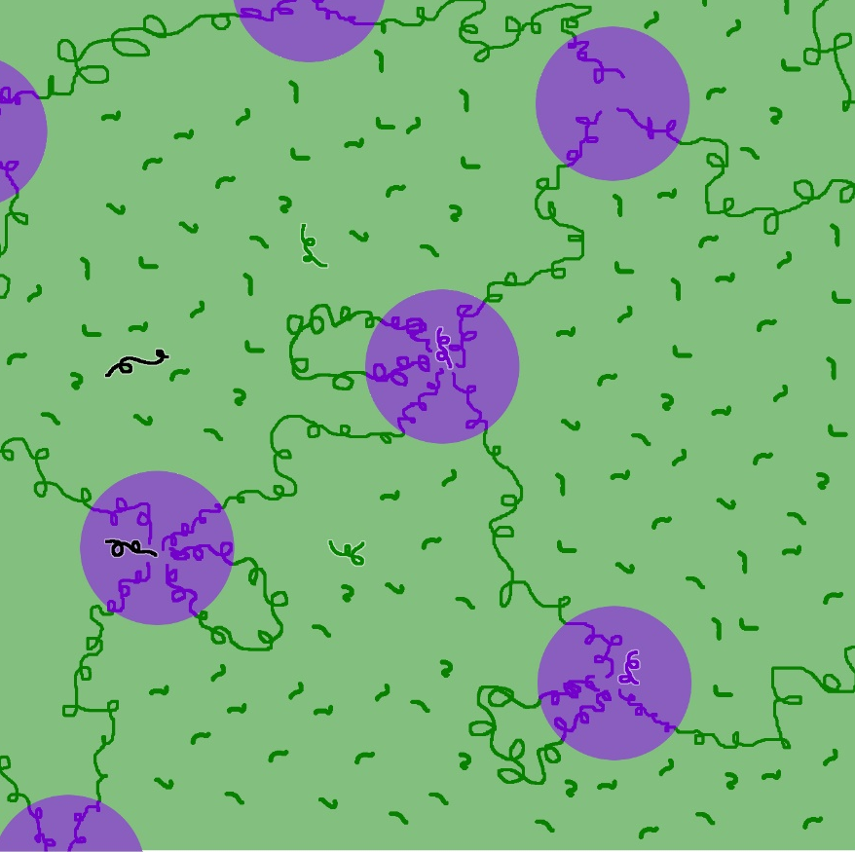
Background
Phase Sensitive Homopolymers
Phase Miscibility
A-selective
B-selective
Non-selective
Styrene
Notes:
One method to control the nanostructure of polymeric gels are to add phase-selective homopolymers
Phase-selective homopolymers have attracted significant attention in the scientific community because they provide an inexpensive and simple method to tune properties of block polymers
Homopolymers have distinct selectivity meaning either the homopolymer is miscible in purple region, green region or is non-selective (denoted by the black arrows)
Specifically, we will investigate A selective homopolymer styrene in an effort to investigate the impact micelle size has on drug delivery

Slide 8
Goals
Quantify the effect of homopolymer concentration on gel nanostructure
Determine the impact of homopolymer concentration on the diffusion of a payload

Slide 9
Hypothesis
We hypothesize that the addition of a discrete phase-selective polymer will cause the polystyrene micelle domains to increase in size resulting in a slower release rate of AOT

Slide 10
Gel Formulation
Formulation
Concentration SEBS (%) | Concentration Styrene Homopolymer (%)
10 | 0.2
10 | 0.5
10 | 0.8
10 | 1.0
15 | 0.2
15 | 0.5
15 | 0.8
15 | 1.0
SEBS constant 10%
SEBS constant 15%

Slide 11
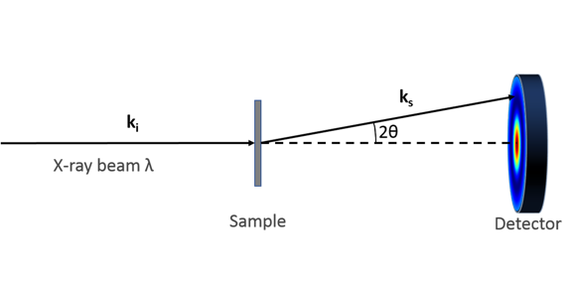
Effect on Gel nanostructure
Small X-Ray Scattering (SAXS):
Notes:
To investigate the nanostructure of polymeric gel small angle x-ray scattering (SAXS) was used
In this method an x-ray is transmitted through a sample the x rays then scatter depending on structure of the sample. The scattering pattern of the x ray is then recorded by a detector.
This scattering pattern is then fit to a theoretical model to determine the nano structure of the polymeric gel

Slide 12
Effect on Gel nanostructure
Notes:
First using SAXS the PS micelle domain size was determined
Because increasing homopolymer results in larger ps amount

Slide 13
Effect on Gel nanostructure
Notes:
Next the distance between PS domains is determined.
These trends were in part due to a decreased EB fraction in polymeric gels and concurrently an increased coiling and entanglement of these EB chains.

Slide 14
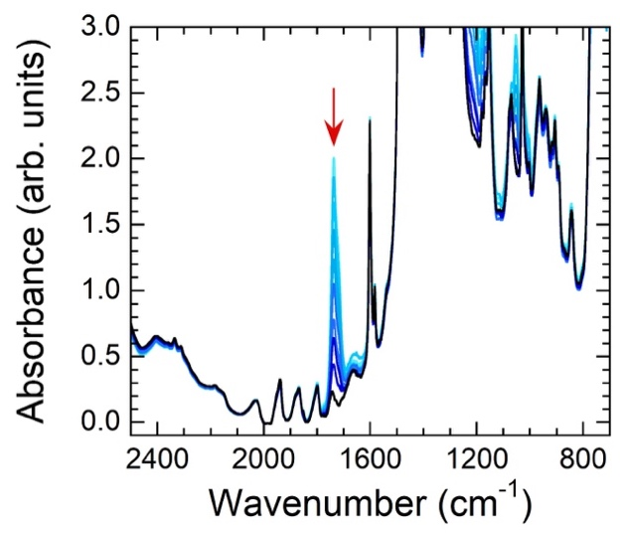
AOT Release
Fourier Transform Infrared Spectroscopy (FTIR) was used:
$$\frac{A_{t}}{A_{0}}= \frac{l_{t}\sum{ε_{i}c_{i,t}}}{l_{0}\sum{ε_{i}c_{i,0}}}$$
$\frac{A_{t}}{A_{0}}= \frac{m_{t}}{m_{0}}$
Notes:
Next to determine the release rate of AOT or diffusion the following flourier transform infrared spectroscopy will be utilized
The goal of the FTIR method is to measure how much infrared (IR) radiation a sample absorbs at a range of wavelengths.
When IR is passed through a sample, some radiation is absorbed by the sample and some is transmitted.
The resulting transmitted IR signal is detected and analyzed.
Since different chemical structures absorb different IR radiation wavelengths, FTIR can produce a unique fingerprint to analyze the chemical composition of a sample.
By tracking the change in absorbance height of the AOT peak at 1740 cm⁻¹ the change in concentration of AOT within the gel sample can be determined using Beer’s Law .
The ratio was further simplified as the pathlength and molar absorptivity remain constant and the volume of the gel does not change
Thus the absorbance can be directly correlated with mass of AOT within the gel

Slide 15
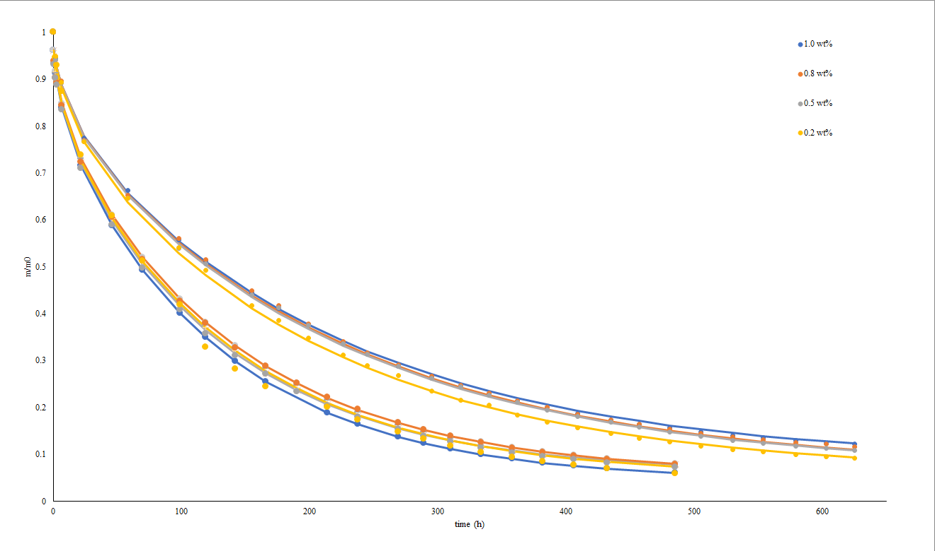
Effect on Gel nanostructure
SEBS 15%
$$\frac{m}{m_{0}}=\frac{8}{π^{2}}exp\left[\frac{−π^{2}D}{4L^{2}}t\right]$$
SEBS 10%
Notes:
Using the FTIR method we observe release curves of AOT with respect of SEBS concnetrations.
From this the transport model represented at the right is is fit to the release curve experimental data to determine the diffusivity of each gel

Slide 16
Gel Diffusivity
Notes:
See diffusivities are constant amount SEBS concentration series and do not change with respect to homopolymer rejecting our hypothesis

Slide 17
Impact of gel Mesh Size
Notes:
This deviation in results can be explained by investigating the mesh size.
Mesh size is the distance between EB chains
Varying the homopolymer amount does not change the mesh size only the addtion of SEBS will decrease the mesh size as more ethylene butylene chains are added.
Furthermore, the mesh size is significantly smaller in comparison to the PS domain size (on an order of magnitude)
As a result it can be concluded that the mesh size has a significant impact on the diffusion on AOT while the impact of diffusion due to changing PS domain size is negligible.

Slide 18
Conclusions
Addition of homopolymer at constant concentrations of SEBS increases polystyrene domain size but has negligible effect on AOT release rate
Fix amount of polystyrene to isolate effect of homopolymer on gel performance

Slide 19
Questions
Please reach out to me at:
iac002@bucknell.edu

Slide 20
Acknowledgements
Dr. Kenny Mineart
Bucknell ChemE Dept.
Mineart Research Group

